Slide 1
Week 4 Agenda
Authority control and identifiers
Linked data
Lab: Open Refine

Slide 2
Authority Control
Ensuring consistency and accuracy of records
Easing research for catalogers and the public

Slide 3
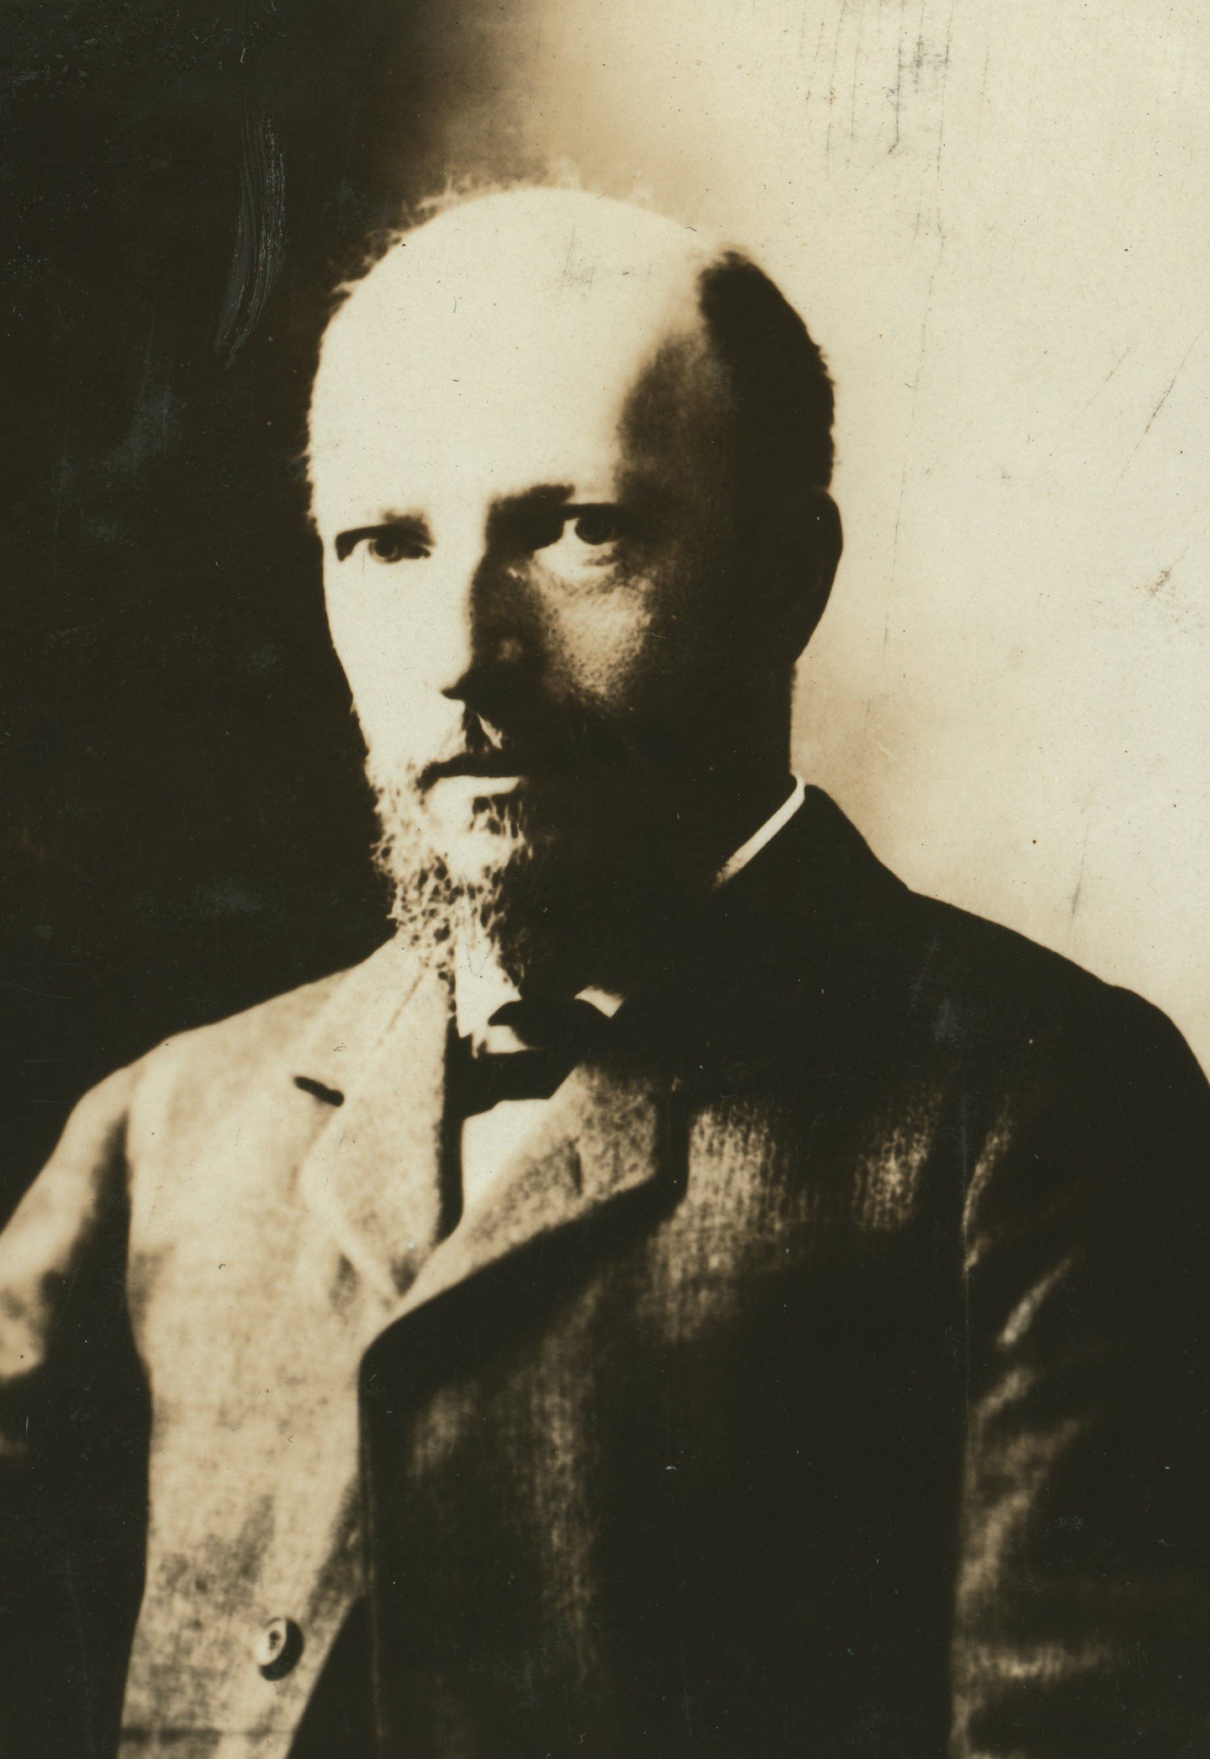
Felix Adler

Slide 4

Felix Adler

Slide 5

Felix Adler

Slide 6
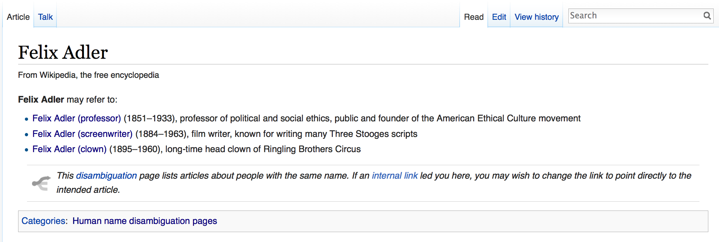
Wikipedia disambiguation page

Slide 7
Felix Adler (professor)
100 1 _ ‎‡a Adler, Felix,‏ ‎‡d 1851-1933

Slide 8
Felix Adler (professor)
100 1 _ ‎‡a Adler, Felix,‏ ‎‡d 1851-1933
Felix Adler (screenwriter)
100 1 _ ‎‡a Adler, Felix,‏ ‎‡d 1884-1963

Slide 9
Felix Adler (professor)
100 1 _ ‎‡a Adler, Felix,‏ ‎‡d 1851-1933
Felix Adler (screenwriter)
100 1 _ ‎‡a Adler, Felix,‏ ‎‡d 1884-1963
Felix Adler (clown)
100 1 _ ‎‡a Adler, Felix,‏ ‎‡d 1895-1960‏

Slide 10
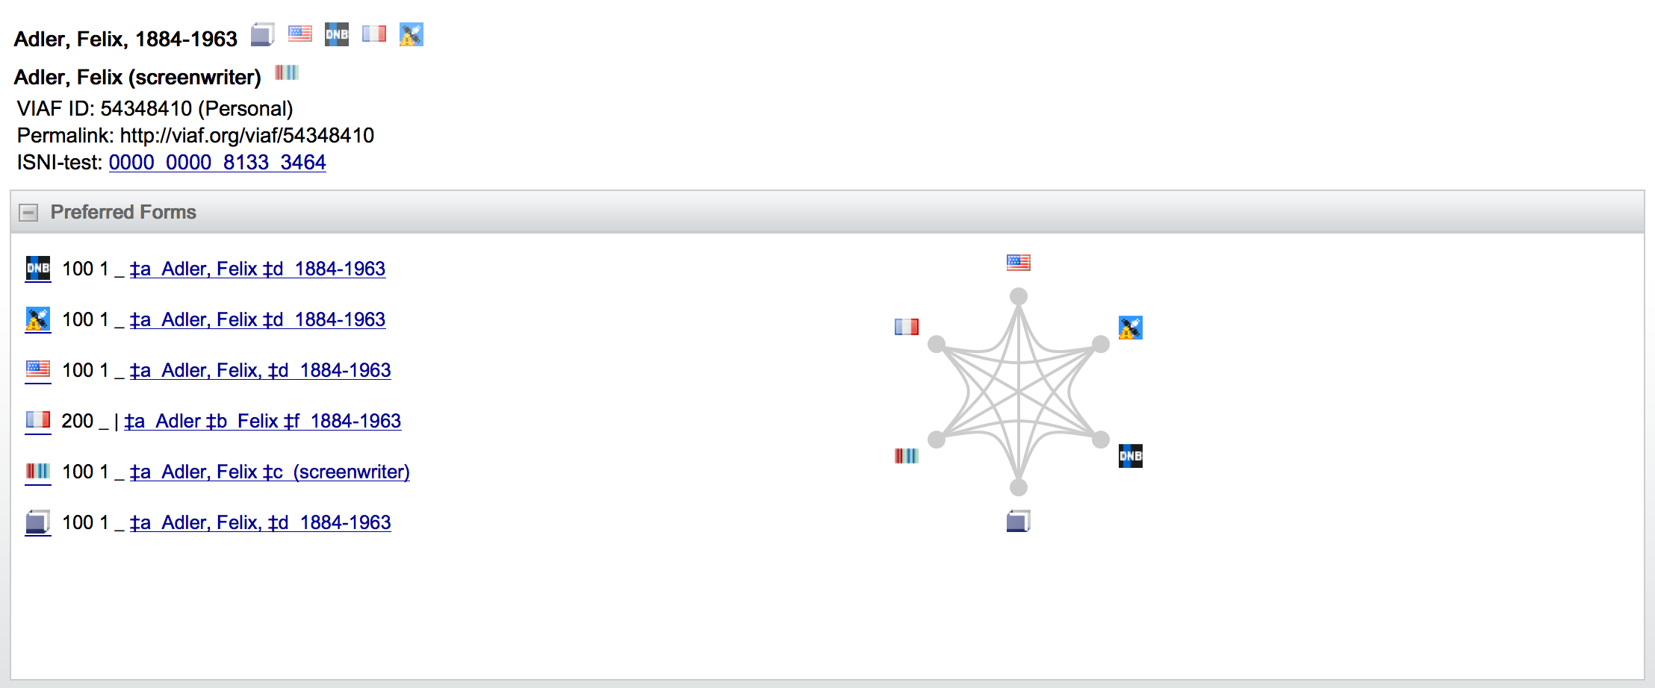
Virtual International Authority File

Slide 11
Virtual International Authority File

Slide 12
Four principles of linked data
Use URIs to denote things.
Use HTTP URIs so that these things can be referred to and looked up ("dereferenced") by people and user agents.
Provide useful information about the thing when its URI is dereferenced, leveraging standards such as RDF, SPARQL.
Include links to other related things (using their URIs) when publishing data on the Web.
Berners-Lee, Tim. “Linked Data: Design Issues.” http://www.w3.org/DesignIssues/LinkedData.html

Slide 13
Blockheads (Laurel and Hardy, 1938)
https://www.youtube.com/watch?v=Y5346Jrunc8

Slide 14
So instead of…
035 $a(OCoLC)78432321
245 00 $aBlockheads.
264 #2 $aHollywood, Ca. : $bNostalgia Merchant, $c1938.
520 World War I buddies, Stan and Ollie, are reunited after 20 years.
700 1# $aHardy, Oliver, $d1892-1957, $4act.
700 1# $aLaurel, Stan, $4act.
700 1# $aAdler, Felix, $d1884-1963, $4aus.

Slide 15
You would get:
<http://worldcat.org/oclc/78432321>
schema:name “Blockheads”
library:oclcnum “78432321”
schema:description “World War I buddies, Stan and Ollie, are reunited after 20 years.”
schema:actor <http://viaf.org/viaf/79076872>
schema:actor <http://viaf.org/viaf/44486990>
schema:author <http://viaf.org/viaf/54348410>
schema:distributor <http://www.imdb.com/company/co0154895> (close enough…)

Slide 16
You would get:
<http://worldcat.org/oclc/78432321>
schema:name “Blockheads”
library:oclcnum “78432321”
schema:description “World War I buddies, Stan and Ollie, are reunited after 20 years.”
schema:actor <http://viaf.org/viaf/79076872>
schema:actor <http://viaf.org/viaf/44486990>
schema:author <http://viaf.org/viaf/54348410>
schema:distributor <http://www.imdb.com/company/co0154895> (close enough…)

Slide 17
owl:sameAs
Allows to link equivalent entities from different authority files
This thing is the same as That thing

Slide 18
owl:sameAs
<viaf.org/viaf/54348410>
owl:sameAs http://d-nb.info/gnd/14196250X
owl:sameAs http://id.loc.gov/authorities/names/no2010058681
owl:sameAs http://catalogue.bnf.fr/ark:/12148/cb14044476v
etc.

Slide 19
Authority control + linked data
Reduce ambiguity
Create more links within records
Cover all descriptive use cases
Internationalization, multiple languages
Different spellings
Inconsistent or unknown life dates

Slide 20
Authority control + linked data
Reduce ambiguity
Create more links within records
Cover all descriptive use cases
Internationalization, multiple languages
Different spellings
Inconsistent or unknown life dates
To do that we need cleaned-up metadata…

Slide 21
Lab #4
Open Refine: http://openrefine.org
Download the software for your OS
(Windows, Mac, Linux)

